Slide 1
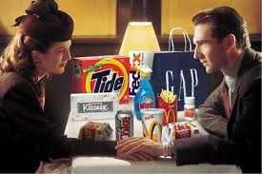
Marketing
Advertising: Product Placement

Slide 2
Objective:
Learn and define Advertising
Learn the Types of Advertising
Learn and Define Product Placement

Slide 3
Advertising:
a paid form of communication sent out by a business about a product (good service or idea)
One way communication – you can’t ask it a question.
  Purpose #1: AIDA
  Purpose #2: Communicates with potential customers to build customer opinions and brand image.

Slide 4
Many Types of Advertising.
We will start with one that as a small business owner you can’t afford
You should know it and recognize it as a consumer

Slide 5

Product Placement
Product Placement: purposeful incorporation of commercial content into noncommercial settings
  Companies pay/trade to have their product, brand or service “Placed” in
  Used by large fortune 500 companies that can afford this as very expensive
  Doesn’t look like a commercial – “Stealth advertising”

Slide 6

What Venues are Used?
Based on the Definition, where have you seen Product Placement
- purposeful incorporation of commercial content into noncommercial settings
Movies
TV
Radio
Video Games
Music Videos
Books

Slide 7
SAY IT, SEE IT, USE IT
How to find Product Placement:
SAY IT : Mentioned by brand name
  Yes: “Can you get me the Cass Clay Milk”
  No: “Can you pass the Milk”
SEE IT Shown (not used) in movie/show
  Yes: Tropicana Orange juice is on the counter, nothing to do with the scene, but camera slowly pans over the product
USE IT Product used during movie/show AND brand is clearly defined/recognizable
    Yes Person is wearing Oakley Glasses
    No Person is wearing unrecognized sun glasses

Slide 8

How Many Do You See

Slide 9
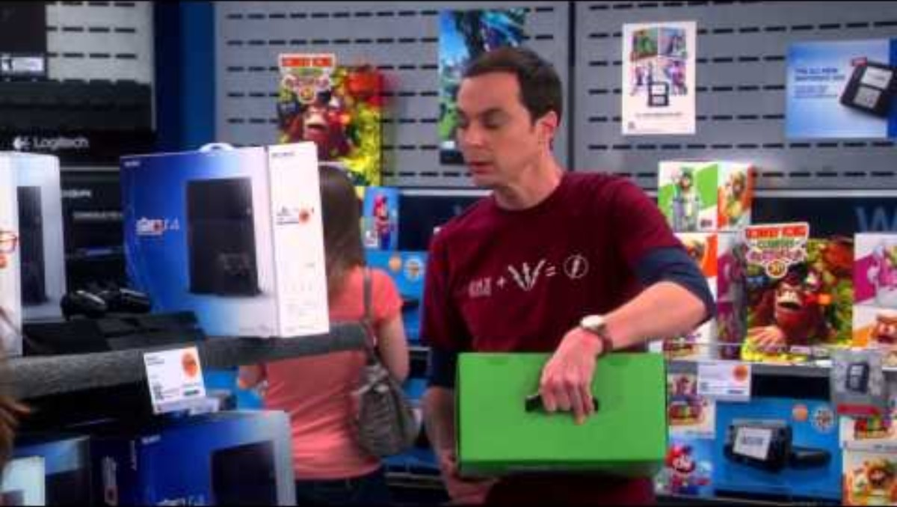
What is the Product and what Method is Used?

Slide 10
Why Use Product Placement
  High audience exposure, visibility, attention, and interest
  The more successful the program, the longer shelf life of the product placement (movies watched for years)
  products should be visible within a scene, but not the focus
  product needs to fit, almost seamlessly (almost being the key word here) into the shot
Increase consumer memory and recall of the brand or product
  Research shows raises brand awareness by 20%
  brands placed in movie scenes enjoy higher brand recall than those that are not

Slide 11
Why use Product Placement?
Show your product being used
  can call attention to several features of a product that a short commercial spot can’t – shows how used
  Doesn’t look like a commercial – “Stealth advertising”
Hundreds of new television stations - no telling what your target market is watching or channel
  Advertising dollars are often wasted on expensive commercials that are used to reach millions –
The popularity of TiVo and similar digital video recorders allows viewers to skip the commercials

Slide 12
Cost of Product Placement
Retainer Fees – Pay large fees
Supply of the main product that is to appear in the movie or television set
Trade: some production companies do not ask for payment but instead ask for sponsorship and advertisement buyouts from the product owner.

Slide 13

Product Placement in Movies
One of the first instances of successful product placement: ET
Sales increased by 65% in 2 weeks following movie release
Hershey’s agreed to promote E.T. for $1 million in advertising; and Hershey could use E.T. in its ads
Notes:
You Tube pic is linked to video

Slide 14
Results of ET
some $35 million worth of Reese's Pieces that year....
$35m in 1982 is worth $111.26m today -

Slide 15
Worksheet
List three places where product placement is “Placed”?
List three ways to recognize product placement?
Name one reason Product placement is used?
What is the first successful use of product placement known?
How much revenue was earned as a result for Hershey’s?

Slide 16
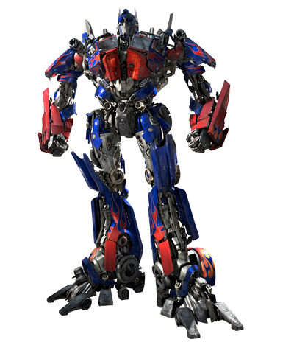
Looking for Product Placements
The 2007 film Transformers is said to include over 70 different product placements
In this activity, we will watch the movie Transformers and list all of the different products/brands/companies that you see during the film

